Slide 1

Depression and its psychosomatic symptoms: a common cold of psychological disorder
Data 621 (Spring 2020) Final Project Presentation Slides
Group 3 : Austin Chan, Katherine Evers, Jose Mawyin, Jimmy Ng

Slide 2
Highlight Summary
According to the Anxiety and Depression Association of America (ADAA), more than 16 million Americans or about 6.7% of the US population (aged 18 or above) is affected by seasonal or chronic depression in any given year
About 322 million people worldwide live with depression in 2017
Severe or untreated prolonged depression would lead to repeated suicidal thoughts and subsequent behavioral changes would associate with self-destructive and suicidal behaviors
Depression is known to associate with multiple psychosomatic symptoms, e.g. fatigue, stomach pain, digestive problem, trouble sleeping, etc.
The clinical data used in this analysis was compiled from five 2017-2018 NHANES data sets on the Centers for Disease Control and Prevention website. NHANES was a program of studies that assessed the health and nutritional status of adults and children in the United States. The five surveys contained data on Mental Health - Depression Screener (DPQ_J), Occupation (OCQ_J), Sleep Disorders (SLQ_J), Current Health Status (HSQ_J), and Smoking - Cigarette Use (SMQ_J).
In this quasi-experimental study, we observed and concurred that
Individuals suffer from chronic fatigue, sleepiness, tend to be more depressed
Healthy individuals tend to be less depressed
Healthy individuals tend to have a more stable and better sleep pattern/quality, and less likely to feel fatigued
It is natural to assume that healthy individuals feel more energetic and less fatigued throughout the day because they sleep more. Our observation did not support such claim as there’s no statistical difference between groups about hours of sleep. Rather, it’s “quality” not “quantity” of sleep that matters.
Healthy individuals tend to be more psychologically resilient and establish healthy lifestyle, e.g. no smoking, have stable job, regular sleep pattern, hours, etc.
Our observation concluded that changes in lifestyle would likely lead to behavioral changes that bring positive impact and alleviation in fighting against depression

Slide 3
Contents
Data Exploration
Variable Relationships
Predicting Mood Disorder

Slide 4

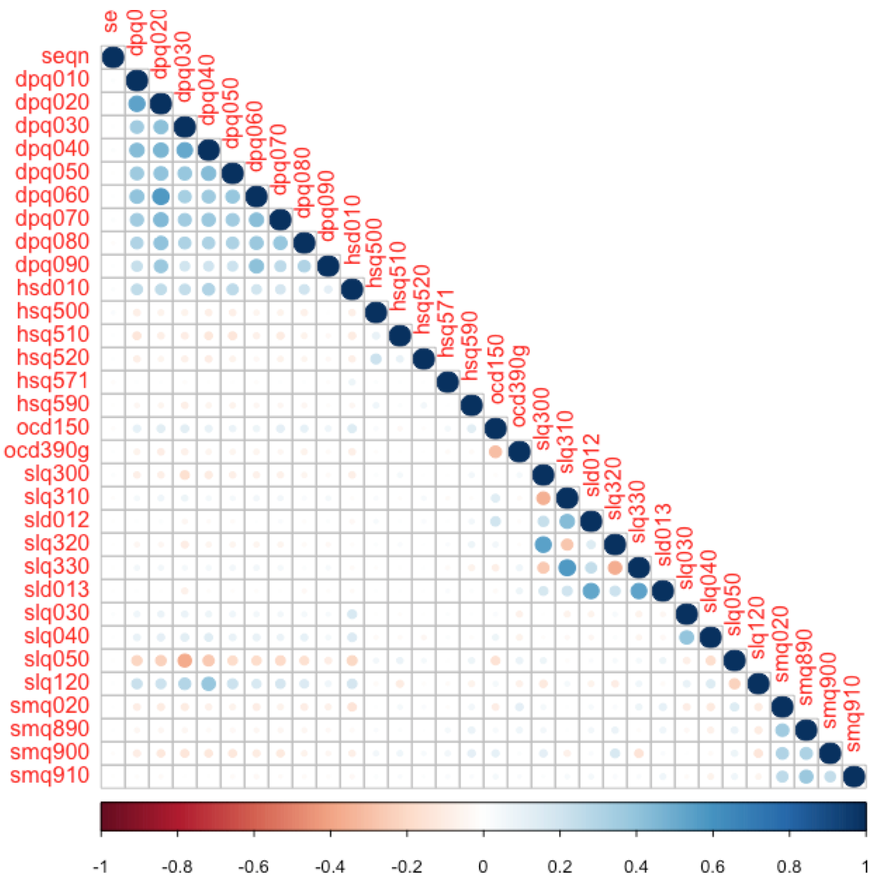
Data Exploration - Correlation Matrix
The chart on the right shows the correlation matrix between every variable in the dataset.
In the top left cluster, we can see that the DPQ questions tend to be positively correlated with each other.
These questions correspond to the indicators of depression.
When someone responds positively to one of the questions, it is likely that they will respond positively to the other questions as well.
This has led us to combine these variables into one “depression indicator” to prevent multicollinearity.
In the bottom middle cluster, we can see that the SLQ questions tend to be positively correlated with each other.
These questions correspond to smoking habits.
When someone responds positively to one of the questions, it is likely that they will respond positively to the other questions as well.
This finding is unsurprising given that people who smoke will tend to try multiple different smoking products.

Slide 5
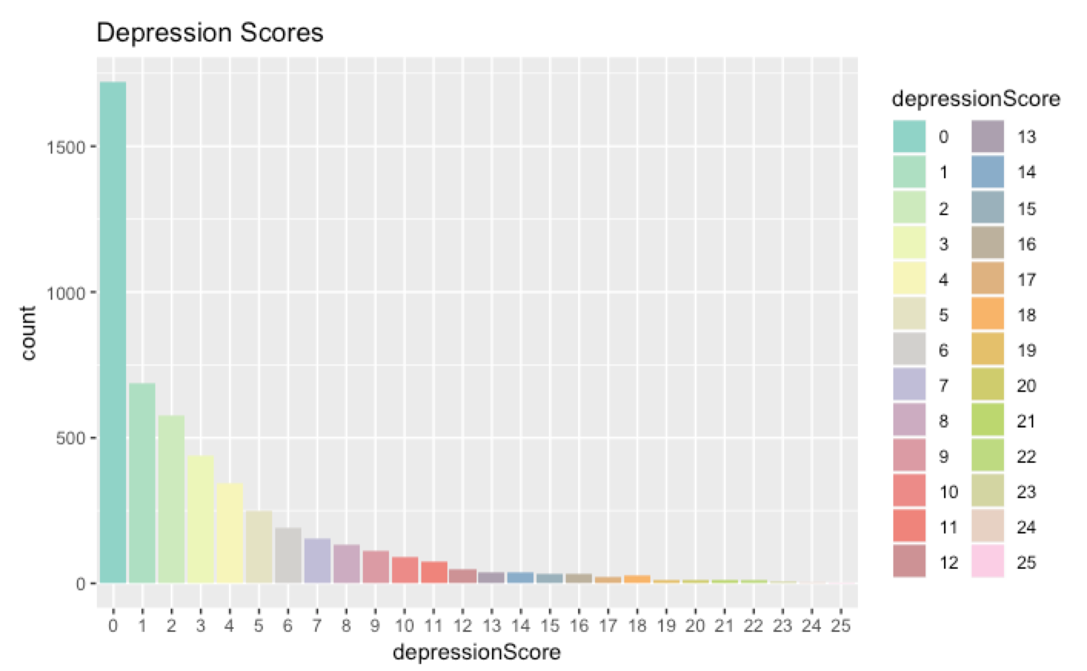
Data Exploration - Depression Score Distribution
The chart on the right shows the distribution of depression scores.
Depression score was calculated by summing the scores from all DPQ questions into one aggregate value.
Notice how a large proportion of depression scores are zero.
Despite having nine separate questions, most individuals respond “no” to all questions.
For classification purposes, we decided that individuals with a score of one or higher were considered “depressed”.
Excluding zero values, there was no distinction made between individuals with higher depression scores vs. lower depression scores for our classification models.
Given that we are not experts in this field, we do not have the knowledge to justify splitting the categories further beyond zero and 1+.

Slide 6
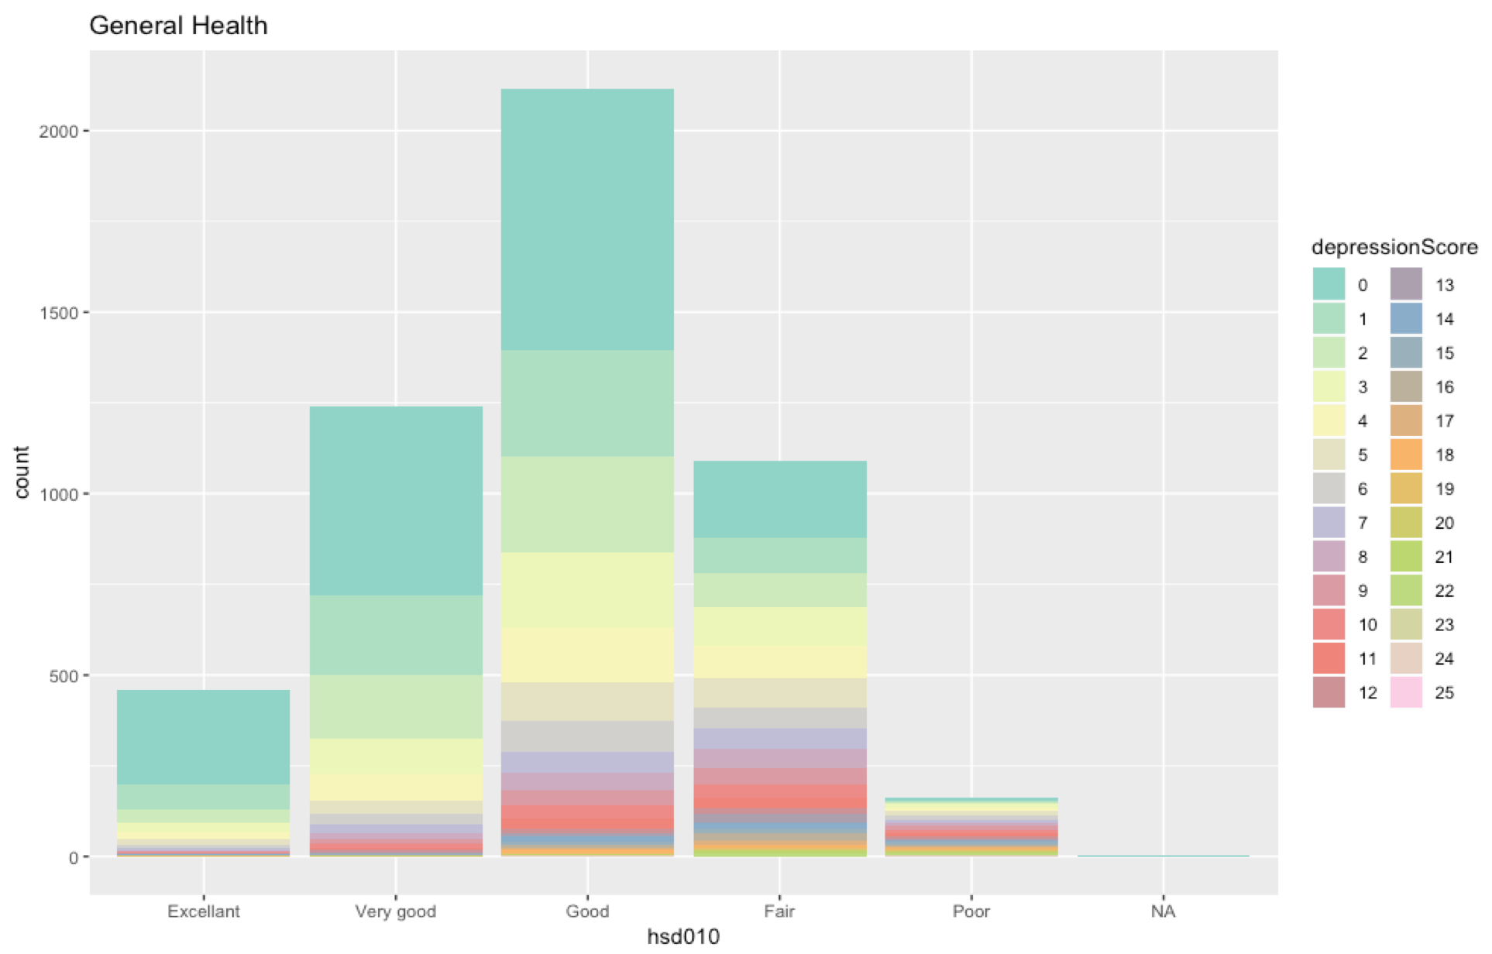
Data Exploration - General Health
The chart on the right shows the distribution of general health condition by depression score.
Notice the proportion of observations with a depression score of zero for each category.
Individuals with better general health tend to have lower depression scores.
Individuals with worse general health tend to have higher depression scores.
Lower depression scores tend to dominate the “Excellent”, “Very Good”, “Good”, and “Fair” categories.
However, the “Poor” category has a more even distribution of depression scores.

Slide 7
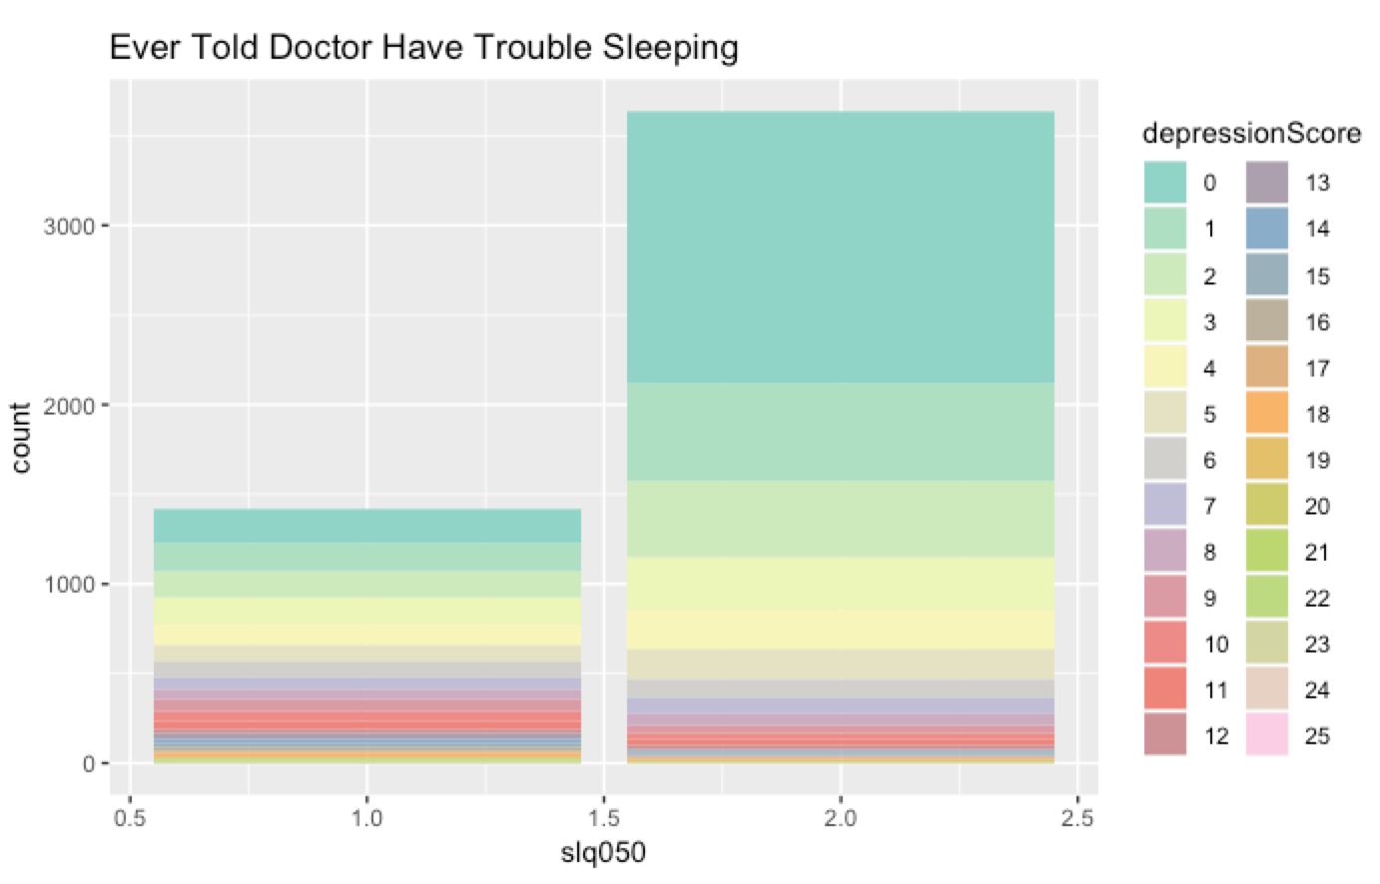
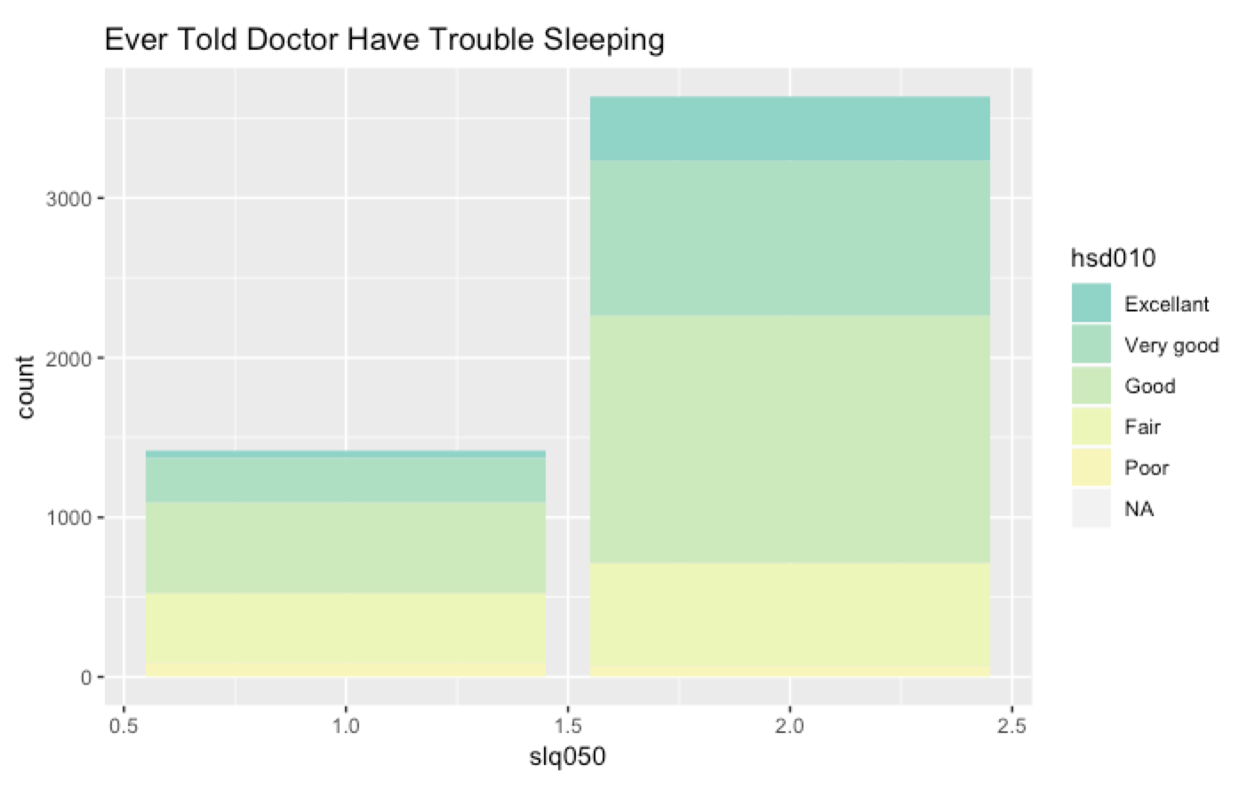
Data Exploration - Trouble Sleeping
The chart on the left shows the distribution of trouble sleeping by depression score.
The chart on the right shows the distribution of trouble sleeping by health condition.
Notice the relative proportion of observations with a depression score of zero for each category.
Individuals with lower depression scores are less likely to report that they have trouble sleeping.
Notice the relative proportion of observations with a health condition of Poor.
There is a higher proportion of individuals with poor health who have reported that they have trouble sleeping.
There is a possible confounding factor between depression, general health condition, and trouble sleeping.

Slide 8
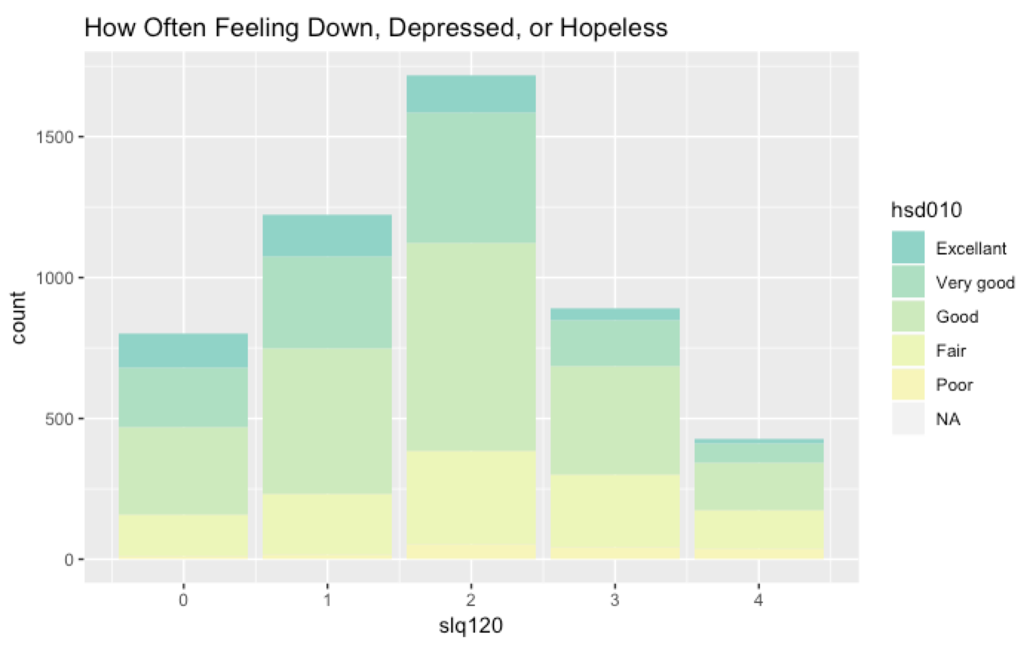
Data Exploration - Hopelessness
The chart on the right shows the distribution of hopelessness by general health condition.
For the most part, individuals with Fair or better health condition tend to exhibit lower hopelessness scores compared to those with Poor health condition.
Looking at category 4 (individuals with a high hopelessness score), we can see that the relative proportion of individuals with Poor health is higher compared to other categories of hopelessness.
These observations suggest that there could be a moderate correlation between hopelessness and health condition.

Slide 9
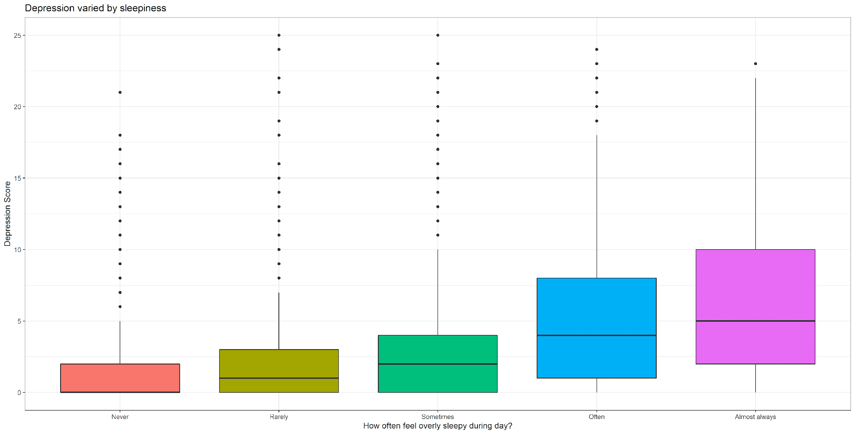
Variable Relationships:
Depression and Chronic Fatigue
A one-way between subject ANOVA was conducted to compare the effect of chronic fatigue associated with severity of depression (score from 0 - not depressed at all, to 27 - clinically depressed). There was a significant effect of level of fatigue at the p < .00 for the five conditions [F(4, 5055) = 204.5, p = 0.00]. A post hoc Tukey HSD further demonstrated that there's no difference between people who were never or rarely tired, but there's significant differences among other conditions. In general, the level of chronic fatigue is statistically, significantly associated with higher level of depression.

Slide 10
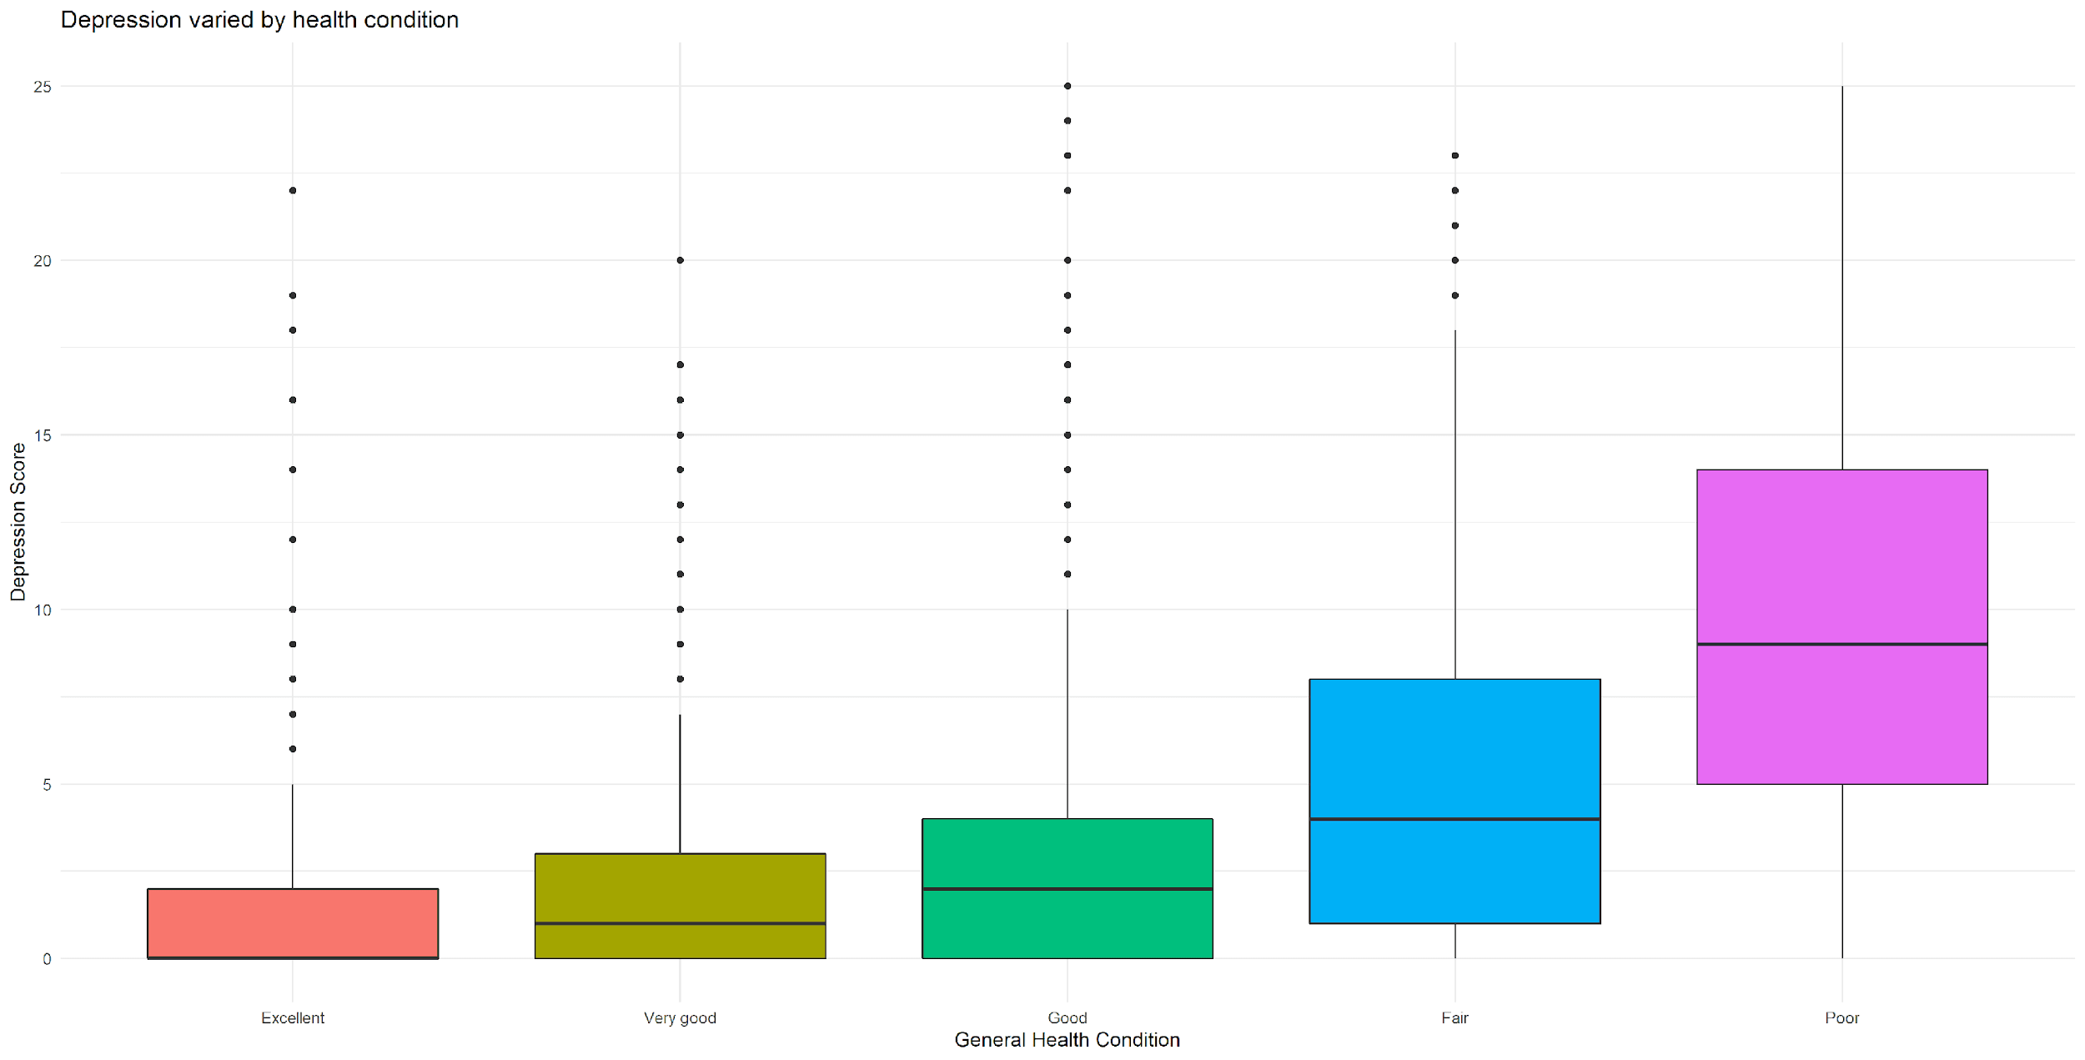
Variable Relationships:
Depression and Physical Health Condition
A one-way between subject ANOVA was conducted to compare the effect of physical health condition associated with the severity of depression. There was a significant effect of physical health condition at the p < .00 for the five conditions [F(4, 5061) = 244, p = 0.00]. A post hoc Tukey HSD further demonstrated that there's no difference between people who reported to be in very good or excellent health, but there's significant differences among other conditions. In general, the level of physical health condition is statistically, significantly associated with levels of depression. Poor health condition is more likely to associate with depression.

Slide 11
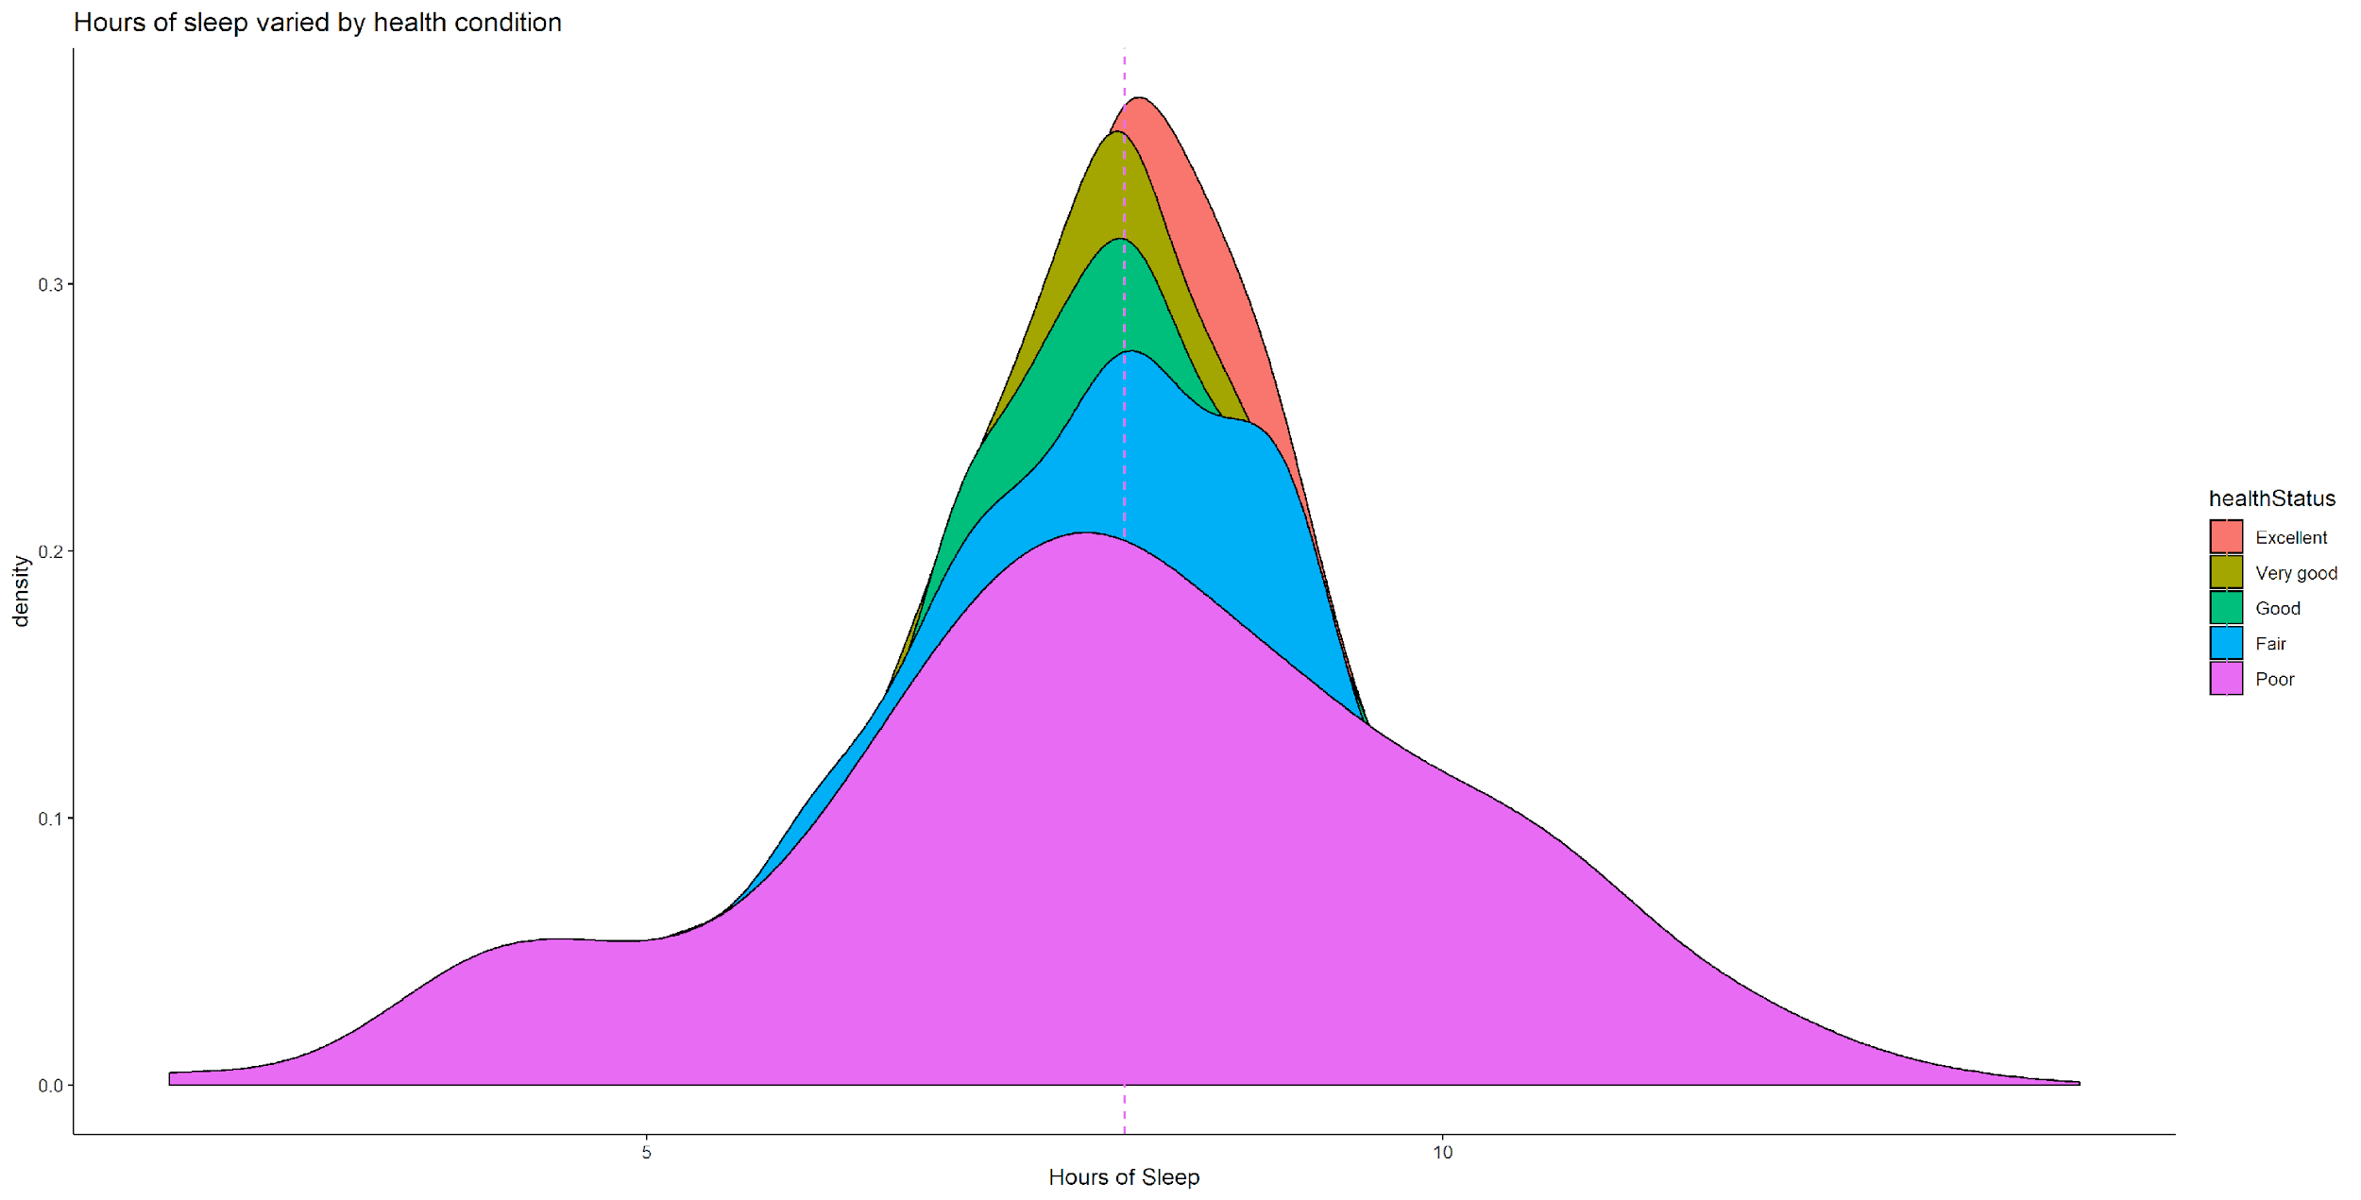
Variable Relationships:
Health and Sleep Hours
There is no statistical evidence in associating length of sleep with general health condition. In other words, people varied in physical health conditions, do not statistically differ in the number of hours of sleep per night. Everyone sleeps on average 7.5 hours at night. It is speculated that they differ in the “quality” not “quantity” of sleep.

Slide 12
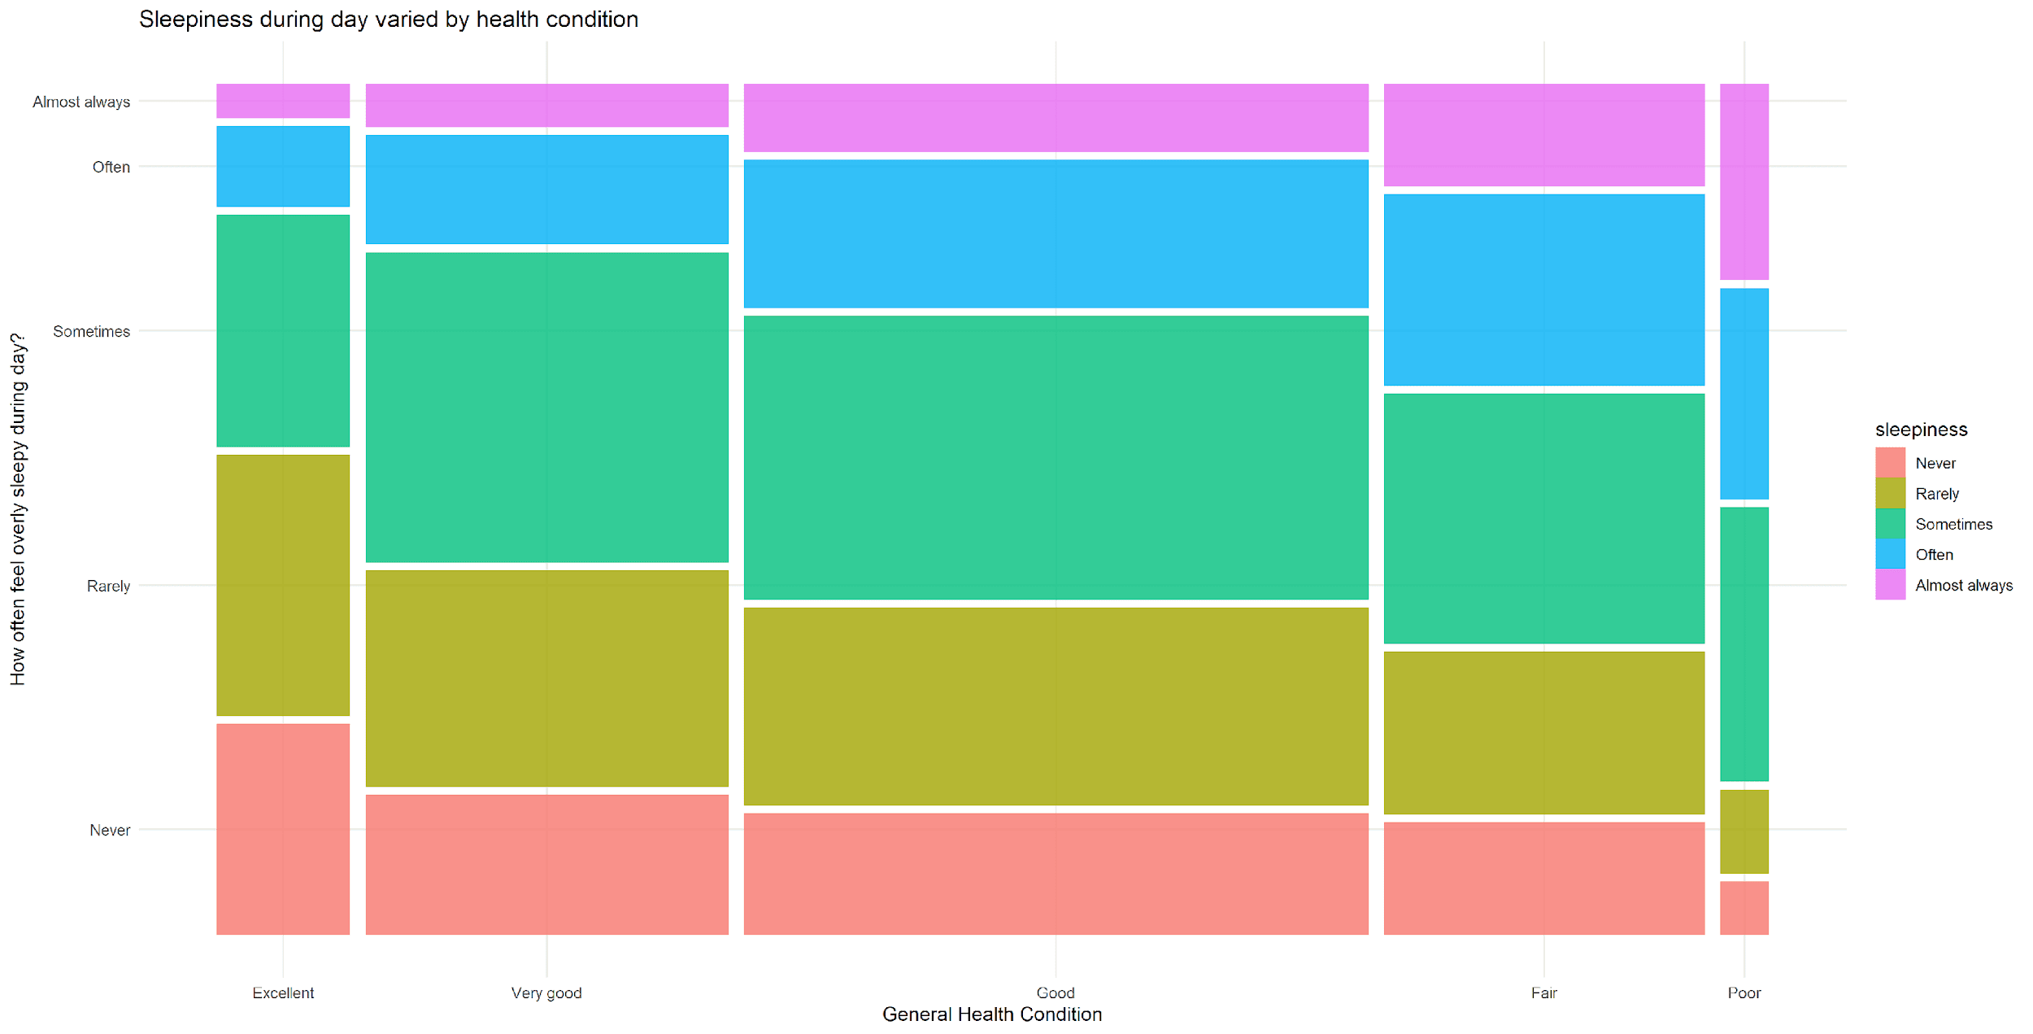
Variable Relationships:
Health Condition and Fatigue
There is a significant relationship between the two variables, X² (16, N = 5126) = 20504, p < .00. Essentially, healthy individuals are less likely to feel fatigue throughout the day. On the other hand, individuals with fair or poor health condition are more likely to feel tired. In other words, fatigue is an indicator of poor health and it can reveal a person’s underlying physical and psychological problem.

Slide 13
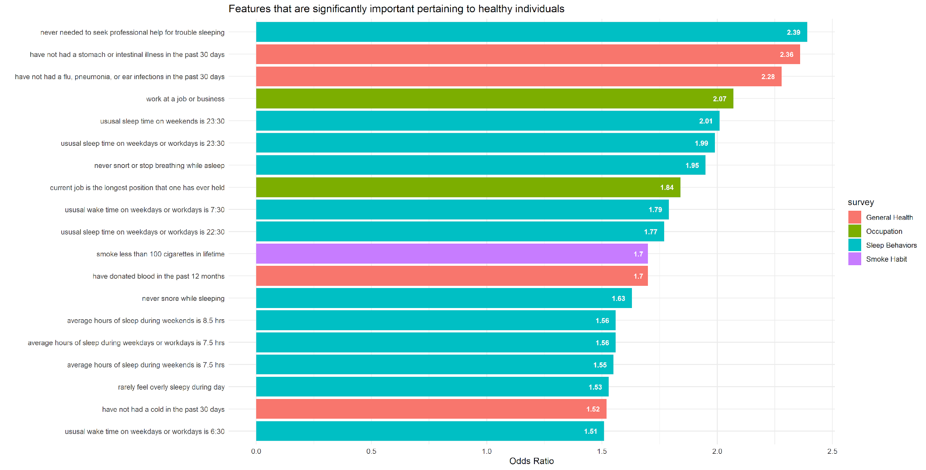
Variable Relationships:
Lifestyle matters
Below is a list of features that are found important for healthy individuals (comparing to people with poor health condition). For example, healthy individuals are 2.4 times less likely to seek professional help because of trouble sleeping, and they are also 2.4 times less likely to have any stomach or intestinal illness in the past 30 days. Moreover, they are 2 times more likely to work at a job or business; they have a much more regular sleep pattern, sleep hours; they are less likely to have smoked more than 100 cigarettes in life, etc. Essentially, they adopt a more wholesome and vigorous lifestyle, which develops a strong buffer that defends against depression.

Slide 14
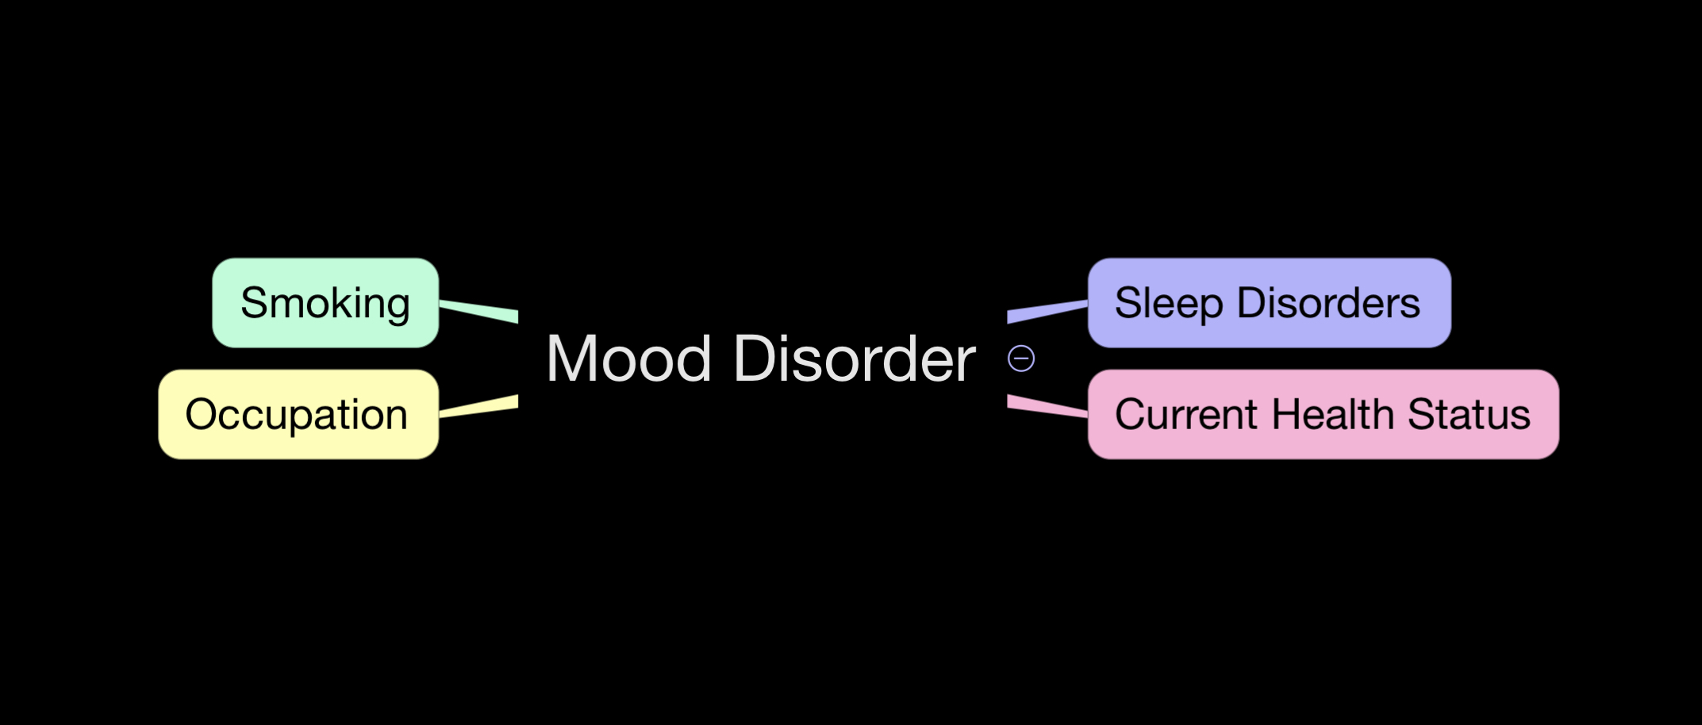
Predicting Mood Disorder
Imagine that you could have a person fill up a series of questionnaires regarding mental, health and emotional well being. Could we use these as indicators to predict if the person is likely to experience a mood disorder?

Slide 15
Predicting Mood Disorder
We analyzed data from 8 Current Health Status, 2 Occupation, 10 Sleep Disorders and 5 Smoking indicators as predictors to the aggregate of 9 Mental Health indicators. From the initial set of predictor variables we selected the following showing the highest correlation coefficients:
HSD010 - General health condition (Factor with 5 levels Excellent, Very good,Good, Fair or Poor)
HSQ500 - SP have head cold or chest cold (Factor with 2 level Yes or No)
HSQ510 - SP have stomach or intestinal illness? (Factor with 2 level Yes or No)
HSQ520 - SP have flu, pneumonia, ear infection? (Factor with 2 level Yes or No)
HSQ571 - SP donated blood in the past 12 months? (Factor with 2 level Yes or No)
OCD150 - Type of work done last week (Factor with 4 levels Working at a job or business, With a job or business but not at work, Looking for work, or Not working at a job or business.)
SLD012 - Sleep hours - weekdays or workdays (Number from 2 to 14)
SLD013 - Sleep hours - weekends (Number from 2 to 14)
SLQ030 - How often do you snore? (Factor with 4 levels Never, Rarely, Occasionally or Frequently)
SMQ020 - Smoked at least 100 cigarettes in life (Factor with 2 level Yes or No)

Slide 16
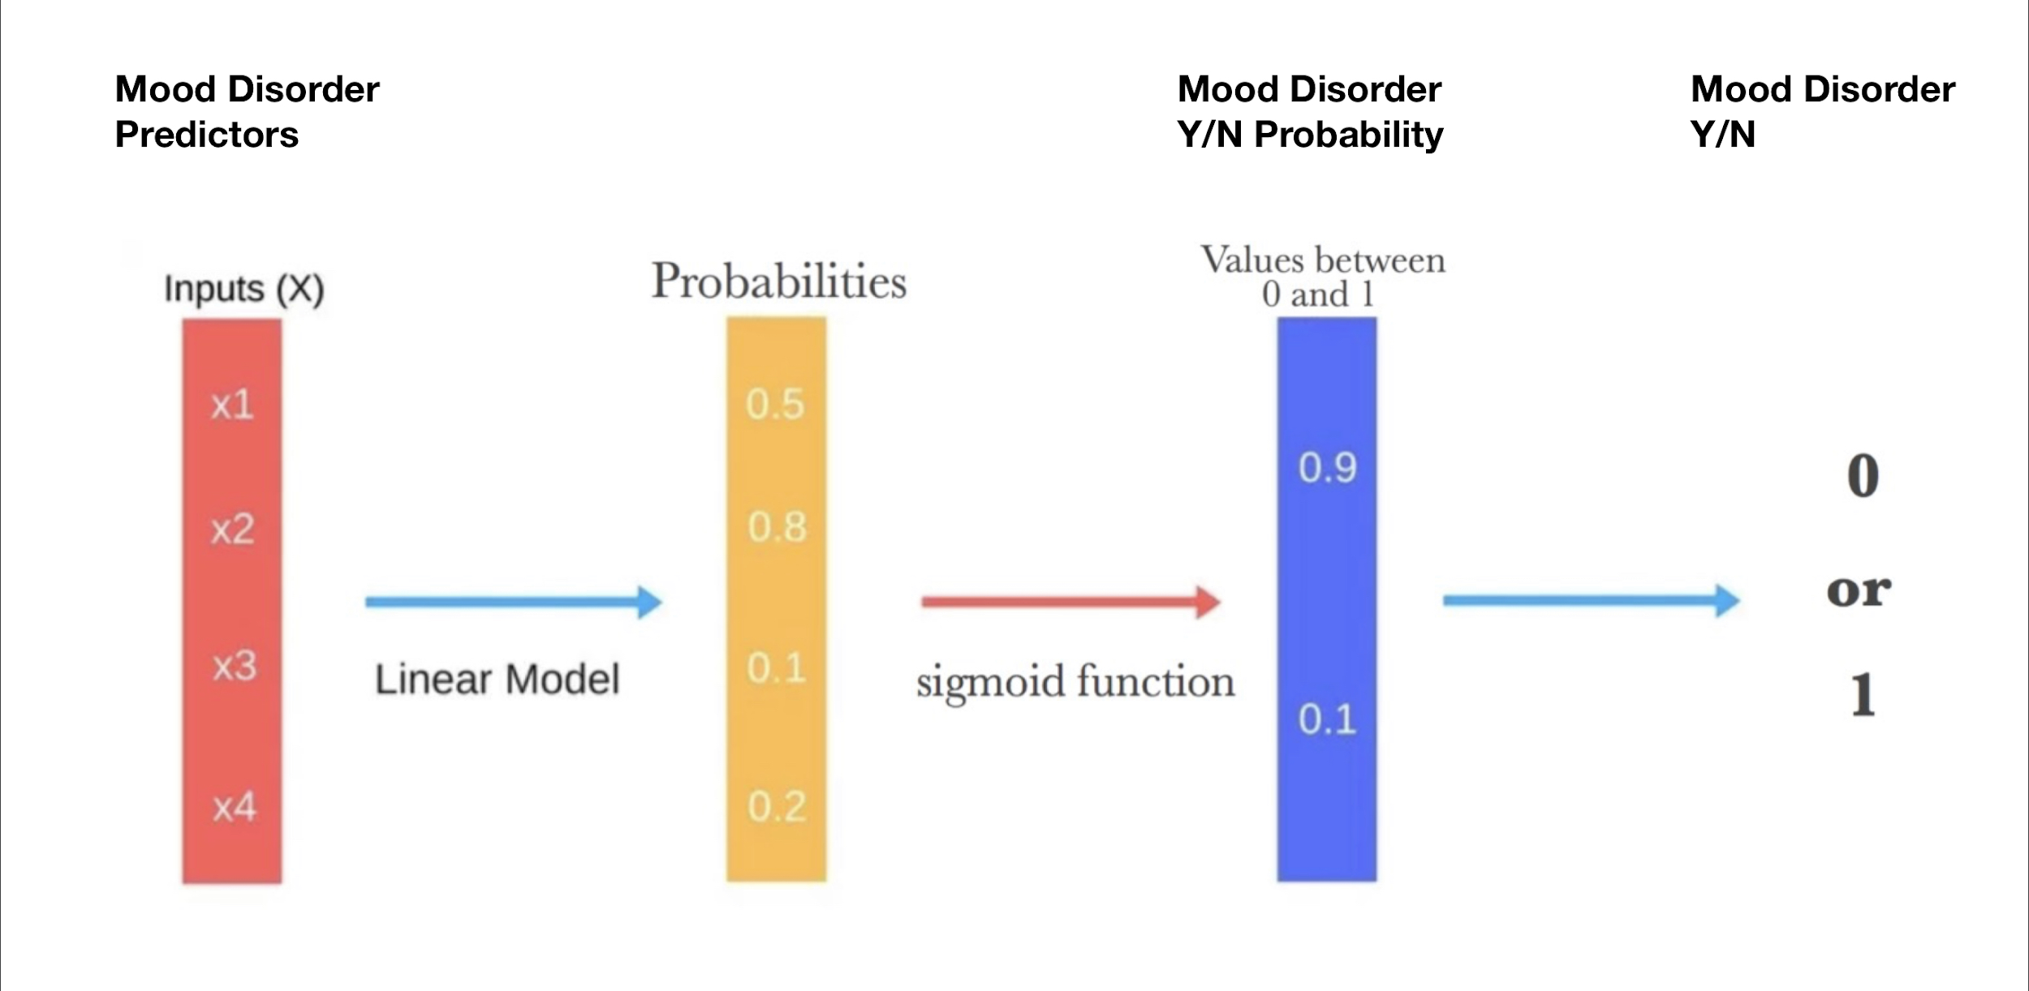
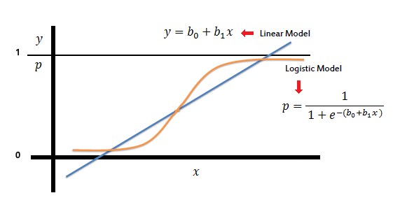
Predicting Mood Disorder
We used the predictors to generate a Binomial Logistic Regression Model that could predict if a person was experiencing a Mood Disorder or not. Instead of predicting a continuous response, as is the case of Linear Regression, Logistic Regression will generate the probability of the response being one of a categorical set of states. In our case, Yes or No experiencing a Mood Disorder.

Slide 17
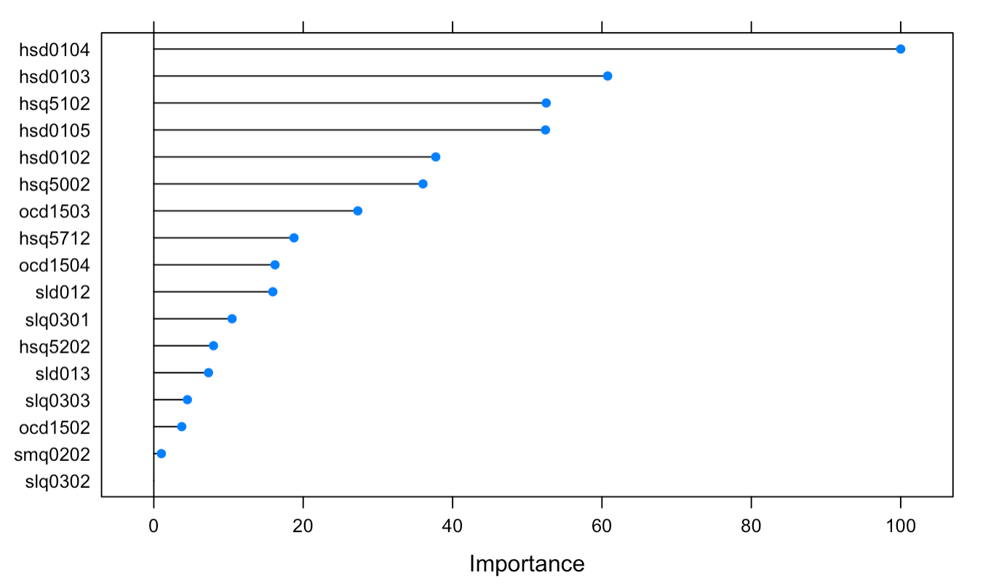
Predicting Mood Disorder
Using our logistic model we calculated the most significant predictor variables with the highest statistical significance in determining the likely Yes/No Mood Disorder state of a person.
The Top 4 Predictors:
HSD010 - General health condition (Factor with 5 levels Excellent, Very good,Good, Fair or Poor)
HSQ510 - SP have stomach or intestinal illness? (Factor with 2 level Yes or No)
HSQ500 - SP have head cold or chest cold (Factor with 2 level Yes or No)
OCD150 - Type of work done last week (Factor with 4 levels Working at a job or business, With a job or business but not at work, Looking for work, or Not working at a job or business.)

Slide 18
Concluding Remarks...
In this quasi-experimental study, we observed that:
Individuals suffer from chronic fatigue, sleepiness, tend to have a higher incidence of depression.
Healthy individuals tend to be have a lower incidence of depression.
Healthy individuals tend to have a more stable and better sleep pattern/quality, and less likely to feel fatigued.
It is natural to assume that healthy individuals feel more energetic and less fatigued throughout the day because they sleep more. Our observation did not support such claim as there’s no statistical difference between groups about hours of sleep. Rather, it’s “quality” not “quantity” of sleep that matters.
Healthy individuals tend to be more psychologically resilient and establish healthy lifestyle, e.g. no smoking, have stable job, regular sleep pattern, hours, etc.
Our observation concluded that changes in lifestyle would likely lead to behavioral changes that bring positive impact and alleviation in fighting against depression.
In terms of predictions, it is possible to predict Mood Disorder using variables such as general health condition, stomach/intestinal illness, head/chest cold, and type of work done in the previous week.

